Slide 1
Mission
To harnessing leading-edge technology to empower our business customers with secure and innovative payment solutions to transform banking transactions into opportunities for growth.

Slide 2
Payment Service – Current State
FPMS
Trusek Core Banking
Payment Rail
Virtual IBANs
Admin Portal
BI/Analytics
Payment Portal
Admin Portal
Banking Circle
FX Services
Wire Wand
Onboarding
Reconciliation
LHV
Domestic Payments
Company’s House
KYC
Reporting
Settlement
Cross-border Payments
API
Equals Money
Payment Services integration
Credit Safe
Audit
Reconciliation
Reporting
Settlement
Convera
NCA
TX Monitoring
SAR
Account Management
Client Portal
Modulr
Business rules
Operational Datastore
Ledger
Accounts, Products, Transactions
BACS, CHAPS, FPS
SEPA

Slide 3
Payment Service – Future State
Payment Middleware
BI/Analytics
Virtual IBANs
Web Portal
Banking Circle
Card Processing
KYC
Onboarding
TX Monitoring
Audit/SAR
Wire Wand
FX Services
LHV
Reporting
Settlement
Reconciliation
Integration
Company’s House
Domestic Payments
Equals Money
Payment Services Connectors
Credit Safe
Orchestration
Account Management
Multi-currency Wallet
General Ledger
Cross-border Payments
Convera
NCA
Settlement
Payments
Debit Cards
Loans
Deposits
Accounts
Crypto
Clowd9
BACS, CHAPS, FPS
Orchestration Rules
Ledger DB
Operational Datastore (ODS)
Accounts, Products
SEPA

Slide 4
Core processing – Data flows
Web App
Mobile App
Card Processor
Banking Partner
FX provider
Requests
Notifications
Events
GraphQL
REST (webhook)
Transactions
Data API
Ledger
Action
Orchestrator
Orchestrator
Transactions
Payment Service
FX Service
Card Service
REST
Payment Connector
FX provider Connector
Card Connector
Payment Event Processor
FX Event Processor
Card Event Processor
Banking Partner
FX Provider
Card Processor

Slide 5
Orchestration
Front-end
Service Provider
Virtual IBANs
API Gateway
Banking Circle
FX Services
Payment Service
User Service
LHV
Domestic Payments
User created
Transaction event
Wallet Service
Notification Service
Middle Tier
Front End Services
Orchestrator
Equals Money
Cross-border Payments
Funding events
Events
Card Service
Connectors
Convera
Settlement
DB Events
Events
Ledger Service
Payment Database
Bank of London
BACS, CHAPS, FPS
Verify Identity
FX Service
Card Processor
SEPA
Cards Network
Supporting Layer
KYC Service
Fraud Detection Service
Analytics Service
Logging & Monitoring Service
Users
Analytics Portal
Operation Portal

Slide 6
Leger Service – High level Architecture
REST API
Transaction
Database updates
Ledger DB
Events
Ledger events
Notification Service

Slide 7
Cross-border Payment processing
Requested
Pending
Approved
Sent
Pending Processing
Processed
User Portal
Payment Service
Admin Portal
Payment Connector
Banking Partner
Banking Partner

Slide 8
Payment request attachment upload flow
1. UI validation
2. Start upload
3. Check RBAC
4. Create DB record
5. Return S3 URL
6. Upload file to S3
7. Finalise upload
Front-end
Backend
Backend
Backend
Backend
Frontend
Backend

Slide 9
Domestic Payment processing
Requested
Pending
Sent
Pending Processing
Processed
User Portal
Payment Service
Payment Connector
Banking Partner
Banking Partner

Slide 10
Trusek End of Day
Banking Partners
Banking Circle
Modulr
End of Day Event
Equal Money
Balances
TruSek
Balances
FPMS
LHV
Move Funds
Client Safeguard Account
LHV
BOL

Slide 11
Elevate Start of Day balance-level Reconciliation
Banking Partners
Banking Circle
Start of Day Event
External Balances
Reconciliation Service
Posted Balances
FPMS
Equal Money
Banking Adapter
Bank of London
External Balances
Card Processors
Cloud 9
Card Processor Adapter
Ledger Balances

Slide 12
Elevate End of Day balance-level Reconciliation
Banking Partners
Banking Circle
End of Day Event
External Balances
Reconciliation Service
Posted Balances
FPMS
Equal Money
Banking Adapter
Bank of London
Move Funds
Bank of London
Card Processors
Cloud 9
External Balances
Card Processor Adapter
Ledger Balances
Client Safeguard Account

Slide 13
Elevate Transaction reconciliation
Admin Portal
Banking Partners
Banking Circle
End of Day Event
Equal Money
Statements
Reconciliation Service
Banking Adapter
Reconciliation issues
Bank of London
Card Processors
Reconciliations
Card Network
Settlement files
Card Processor Adapter
Ledger Journal

Slide 14
UI deliverables
UI
User Portal
Admin Portal
Mobile Banking
CRUD UI
Transaction UI
Operations UI
Maintain Customers
Maintain Accounts
Payments
Foreign Exchange
Cards
FX Quote
Request FX Quote
Accept FX Quote
Execute FX
Create Customer
Update Customer
Create Account
Approve Customer
Maintain Beneficiaries
Create Beneficiary
Approve Beneficiary
Execution Notification
Create Payment request
Payment request notification
Link Internal a/c to external a/c
Maintain Users (members)
Create member
Update Member
Delete Member
Configure member access rights
Configure member limits
Maintain FX margins
Maintain fees
Search Customer
Search account
Search Members
Search Beneficiaries
Search Transactions
Reconciliation
Daily recon report
Post Adjustments
Landing Page
Submit Payment Request
Obtain FX quote
Submit FX deal
Show wallet balances
Maintain beneficiaries

Slide 15
Transformation Phases
Phases
Discovery
Design
Delivery

Slide 16
Discovery phase
LHV
Equals Money
Convera
Discovery
TruSek
FPMS
Portals
Banking Circle
User Portal
API
Functions
Banking API’s
Admin Portal
Platform
Database
Interfaces
Functions
Processes
End of Day
Reconciliation
Payment Initiation
Manual Tx Entry
User Maintenance
Wallet
BoL

Slide 17
Design phase
Design
Platform
UI
InfoSec
Database
Services
User Portal
Servers
API
Core Banking
Ledger
Orchestration
Reporting
Reconciliation
API Security
Core banking API
Ledger API
Admin Portal
Mobile banking

Slide 18
Delivery Phase
UI
Connectors
User Portal
Admin Portal
Banking Circle
LHV
Convera
Orchestration
Workflow
Delivery
Core Banking
Mobile Banking
A/C Management
Products
Ledger
Database
Functions
API
Processes
Reconciliation
Settlement
API
Analytics
Rules database
Bank of London
Payments
CRUD UI
Transaction UI
Reconciliation UI
Operations UI

Slide 19
WebApp architecture options
Amplify + AppSync + Dynamo DB
Amplify + AppSync Introspection + Aurora cluster
Amplify Data ... (Powered by AppSync + Dynamo DB)
Amplify + Apollo + AppSync + Aurora cluster

Slide 20
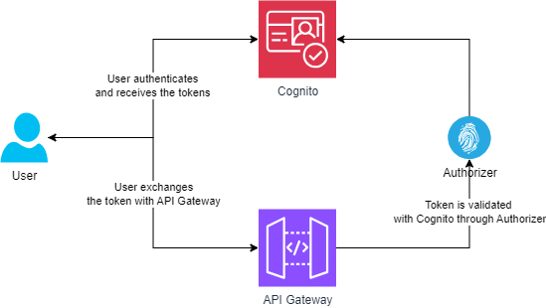
Cognito as Authoriser – High level Architecture

Slide 21
AWS Environments
API Gateway
Code Build EC2
Serverless
Ledger Service ECS
Postgres

Slide 22
Operational Dashboard Landing Page
Users: Ops, Risk, Treasury
Content: Recent payment activities, Exceptions, Reconciliation breaks, User activity, Company balances, overall system health

Slide 23
Development Resources
API Engineer
Design, build, test and deploy API endpoints
AWS/Azure serverless and API Gateway exp.
Platform Engineer
DevOps/Cloud engineering AWS or Azure experience
DevOps tools including Jira, Jenkins, GitHub, Docker
Frontend Engineer
In-depth exp. of core web techs JS, CSS, HTML
Backend Developer
Database Developer
Consume external service provider API’s
Fintech/Payment domain experience
Solid experience in managing and optimising DBMS
Min 5 years working with PostgreSQL and SQL Server
Agile, CI/CD and TDD
Agile CI/CD and TDD
Min 5 years API build in TypeScript
Fintech/Payment domain experience
Min 5 years front-end with NextJS/Remix, React
Interfacing with API endpoints + JWT, MFA
Front-end testing frameworks
Fintech/Payment domain experience
Solid CI/CD, IaC, build Automation, Terraform
ECS, S3, Serverless, API Gateway, SQS, EventBridge
Solid server-side experience with Node.js
Workflow and Business process orchestration
Expertise in schema design, SQL optimal coding
Senior Software Engineer
Experience of high-performance systems development
Solid Rust or C++ experience
Design and build complex backend system/database technologies
REST API design and integration with Postgres and Redis

Slide 24
Roadmap
Ledger Database (31/03)
Orchestrator (30/06)
UI (30/06)
Ledger API (31/05)
Connectors (30/06)
Orchestration (31/08)
Integration (19/09)
UAT (17/10)
Go Live (27/10)

Slide 25
Tasks & Deliverables
Task / Deliverable | Effort (man months)
API integration with 5x banking partners | 10
Core banking for payments + API | 6
Orchestration (Middleware) | 6
Transaction ledger + API | 6
UI | 4
UI integration with middleware | 3
User Acceptance Testing | 4
Security and compliance | 3
Live deployment | 2
Total | 44 ( 6 Team months)

Slide 26
Operations Resources
DevOps/Cloud engineering AWS or Azure experience
DevOps tools including Jira, Jenkins, GitHub, Docker
Frontend Engineer
In-depth exp. of core web techs JS, CSS, HTML
Backend Engineer
Consume external service provider API’s
Fintech/Payment domain experience
Agile CI/CD and TDD
Min 5 years front-end with React
Interfacing with API endpoints + OAuth and MFA
Front-end testing frameworks
Fintech/Payment domain experience
Solid CI/CD, IaC, build Automation, Terraform
ECS, S3, Serverless, API Gateway, SQS, EventBridge
Solid server-side experience with Node.js
Workflow and Business process orchestration
Platform Engineer

Slide 27
Chart of Accounts
World
Banking Partner
Convera
Banking Circle
Bank of London
Frontier
Customer Wallet
Company Cash
Fees Revenue
FX Fees Revenues
Expenses
How much did we transfer to banking partners
How much transaction fees did we collect
How much payment did the customer make
How much fee did the customer pay

Slide 28
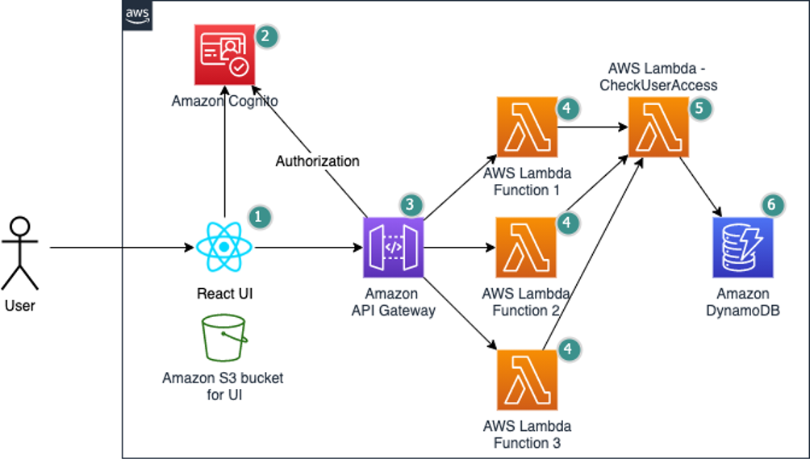
Fine grained authorization – High level Architecture

Slide 29
Key ledger events - Payments
Actor | Event
Customer | Initiates Payment
Payment Service | Confirms initial state of payment request
Compliance | Confirms On-hold state of payment request
Compliance | Confirms Released state of payment request
Banking Partner | Confirm Pending state of payment request
Banking Partner | Confirms Posted state of payment request
Banking Partner | Confirms Settled state of payment request
Archive Process | Confirms Archived state of payment request
Fees service | Confirms transaction fees

Slide 30
Payment beneficiary sanction screening – Future state
Payment type | Pre-Onboarding |  | Pre-transaction | Remarks
Local UK | FPMS | Not necessary |  | carried out manually for all new beneficiaries

Slide 31
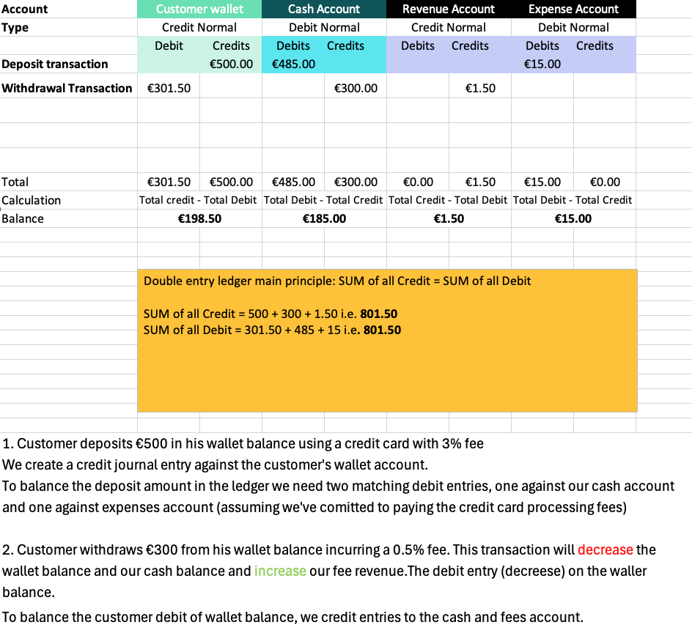
Ledger journal entry scenario

Slide 32
Ledger API - POST Customer Deposit transaction
Account Balances
Identify the Account Type: Determine whether the account is an asset, liability, equity, revenue, or expense account.
Determine the Normal Balance:
Assets, Expenses, and Dividends: Normally have debit balances (increases with debits, decreases with credits).
Liabilities, Revenue, and Equity: Normally have credit balances (increases with credits, decreases with debits).
Sum the Debits and Credits: Add up all the debit entries and credit entries for the specific account.
Calculate the Balance:
Credit normal a/c: total credits. - total debits
Debit normal a/c: Total debits - total credits
{
”ledgerId": ”Payments Ledger”,
“frontierCustomerId”: “NSPCC”,
"transactionDate": "2025-02-25,
"transactionStatus": ”Posted",
"transactionReference": ”NS20250225PAY1",
"description": ”Customer deposit transaction",
"lineItems": [
{
”accountId": ”Customer Wallet", direction: ”credit": “amount": 500
} ,
{
”accountId": ”Cash Account, direction: ”debit": “amount": 485
} ,
{
”accountId": ”Expense Account, direction: ”debit": “amount": 15
} ,
]
}

Slide 33
Ledger API - POST Customer Withdrawal transaction
Account Balances
Identify the Account Type: Determine whether the account is an asset, liability, equity, revenue, or expense account.
Determine the Normal Balance:
Assets, Expenses, and Dividends: Normally have debit balances (increases with debits, decreases with credits).
Liabilities, Revenue, and Equity: Normally have credit balances (increases with credits, decreases with debits).
Sum the Debits and Credits: Add up all the debit entries and credit entries for the specific account.
Calculate the Balance:
Credit normal a/c: total credits. - total debits
Debit normal a/c: Total debits - total credits
{
”ledgerId": ”Payments Ledger”,
“frontierCustomerId”: “NSPCC”
"transactionDate": "2025-02-25",
"transactionStatus": ”Posted",
"transactionReference": ”NS20250225PAY2",
"description": ”Customer withdrawal transaction",
"lineItems": [
{
”accountId": ”Customer Wallet", direction: ”debit": “amount": 301.50
} ,
{
”accountId": ”Cash Account, direction: ”credit": “amount": 300,
} ,
{
”accountId": ”Revenue Account, direction: ”credit": “amount": 1.50
} ,
]
}

Slide 34
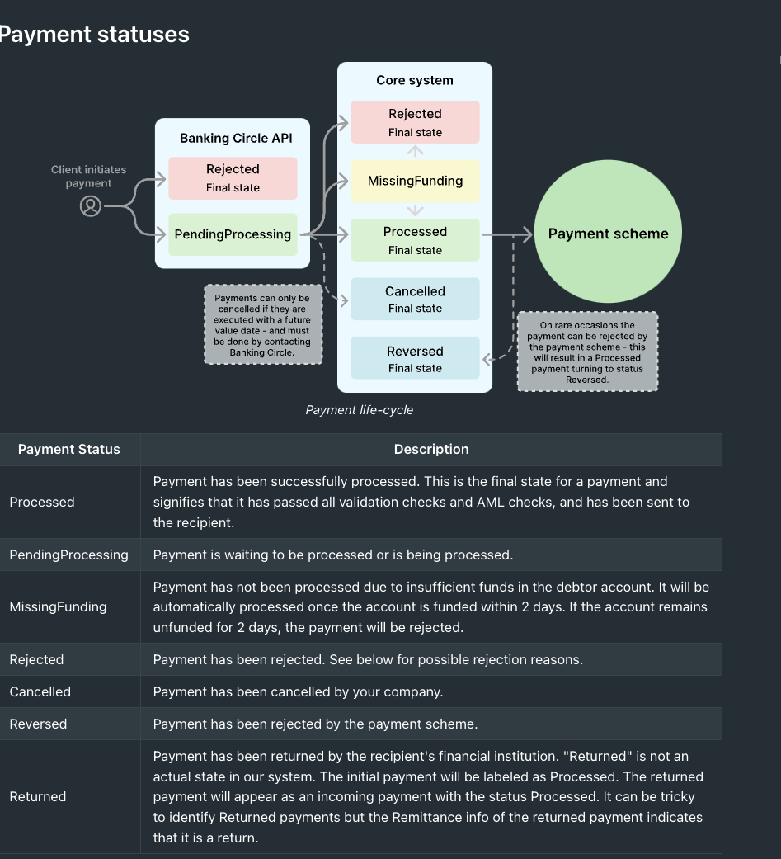
Payment statuses – Banking Circle

Slide 35
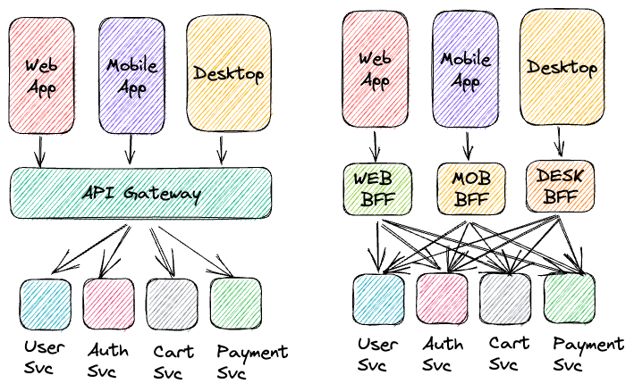
Backend for frontend (BFF)

Slide 36
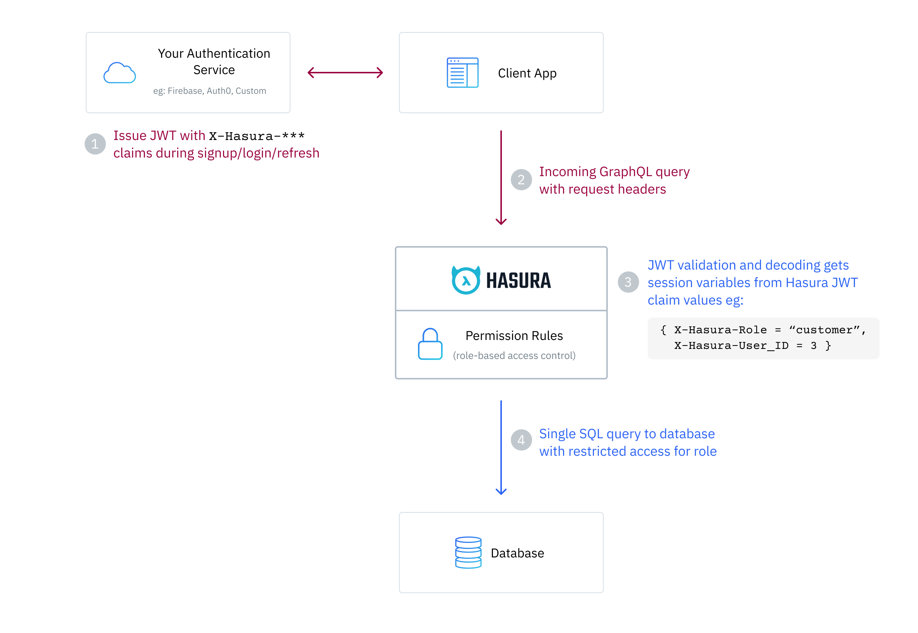
Hasura authentication

Slide 37
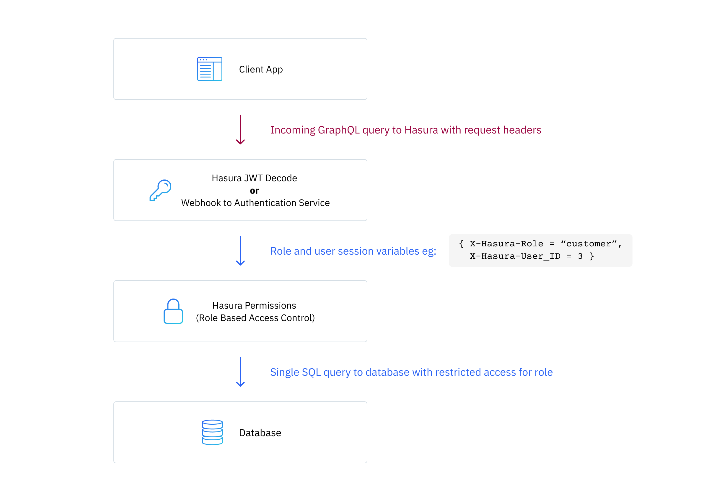
Hasura authentication

Slide 38
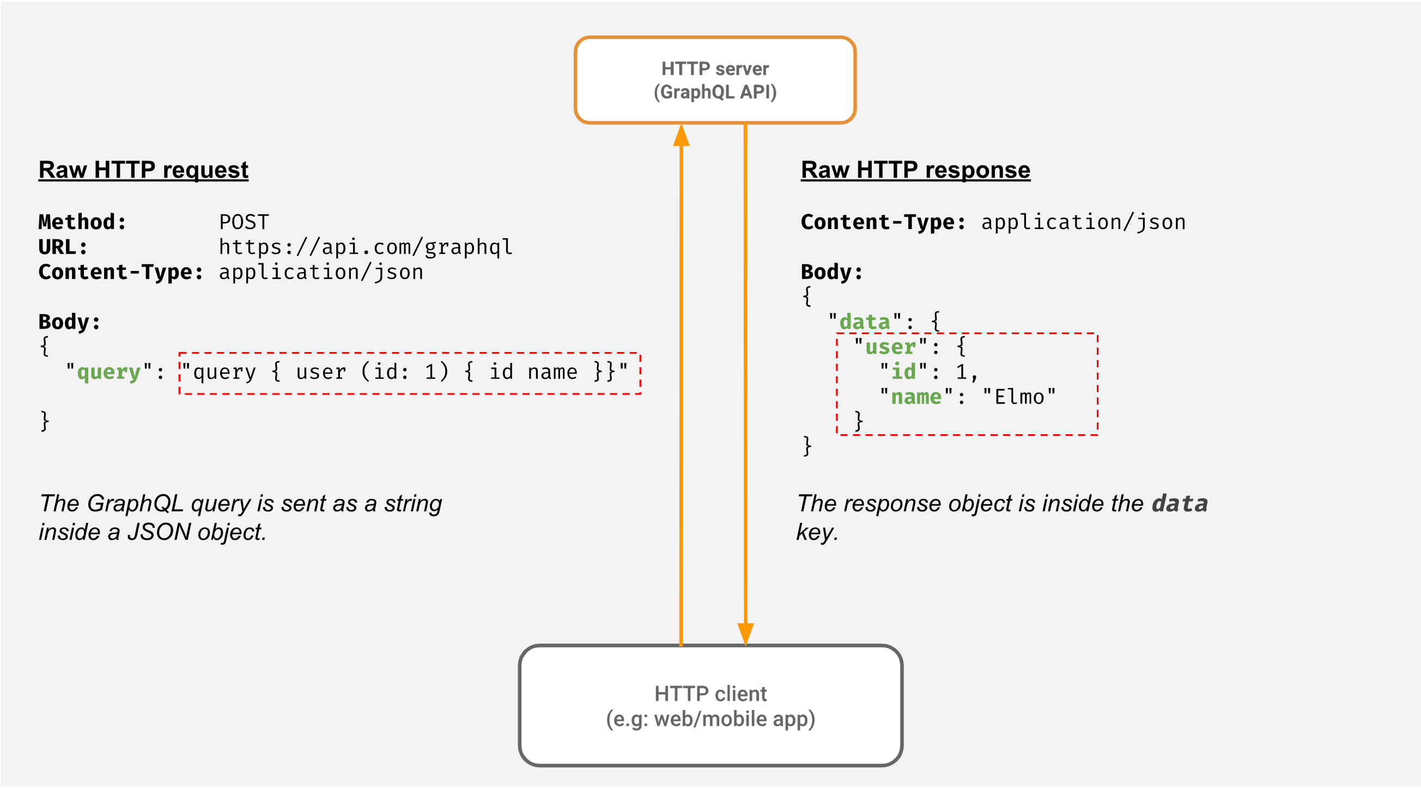
Hasura authentication

Slide 39
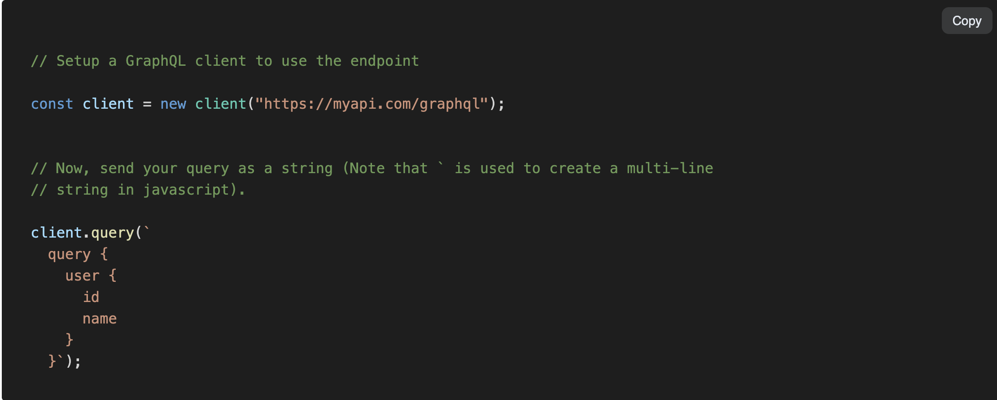
Hasura authentication

Slide 40
Ledger design principles
✅ Guiding Principle
Immutable, append-only ledger entries. Each state transition in a payment's lifecycle should result in new journal entries, not updates to previous ones.
The ledger is a financial event log — not a balance or status tracker.
We model each state change as a separate journal entry (or set of entries), linked to the same payment reference.
🧾 Journal Lifecycle
Only state changes with financial impact are captured
Initiated – Payment is created and sent to bank, funds are reserved
Posted – Payment is wired by the Banking Partner
Settled – Funds are cleared and credited/debited
Failed / Reversed – Error occurred, needs rollback
Refunded – Refund requested or initiated
Payment Lifecycle (Simplified)
Requested – Customer/Operations submit a payment request
Authorized – Payment is approved by Compliance
Initiated – Payment is created and sent to bank, funds are reserved
Posted – Payment is wired by the Banking Partner
Settled – Funds are cleared and credited/debited
Failed / Reversed – Error occurred, needs rollback
Refunded – Refund requested or initiated

Slide 41
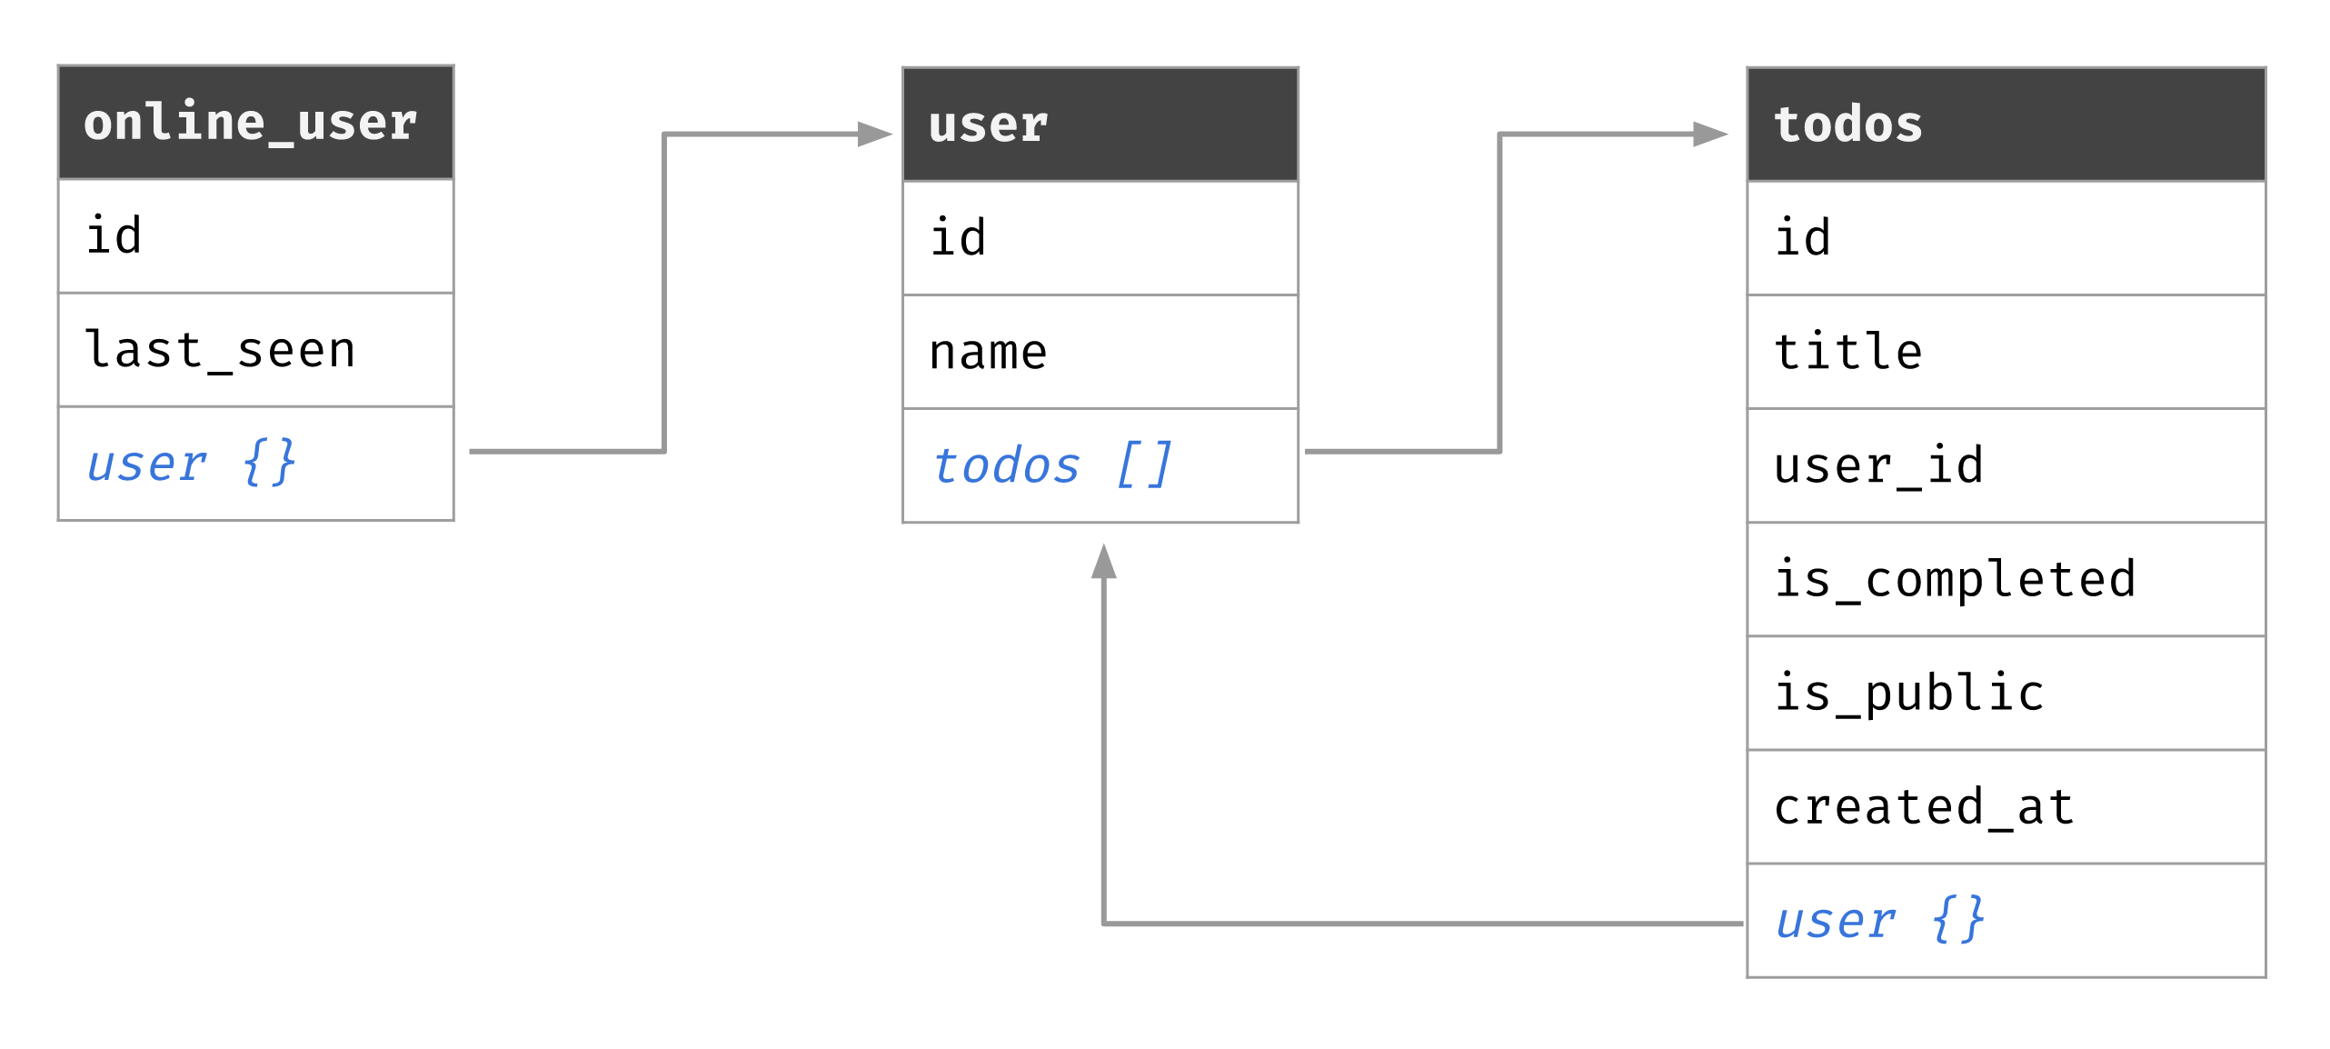
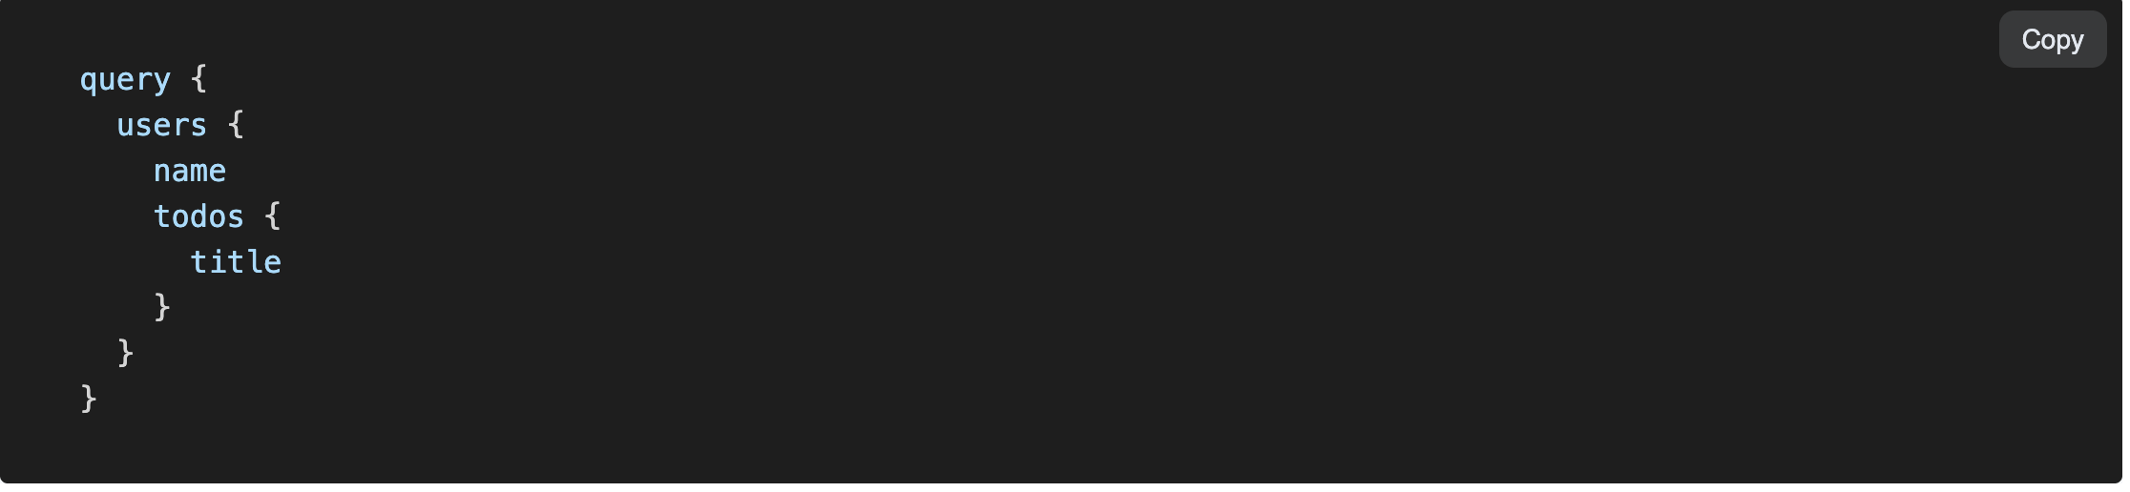
Hasura – Fetching graphs

Slide 42
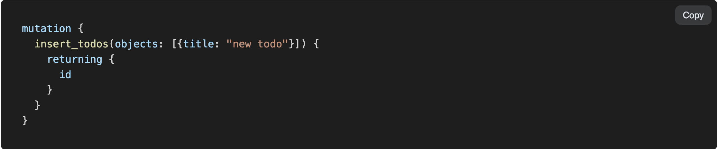
Hasura – Mutation

Slide 43
Hasura authentication

Slide 44
WebApp/ Mobile
Payment request
Graphql server
Transaction details
Payment Database
Status update
HTTP Endpoint
1
2
3
4
Validation checks
Compliance checks
Banking Connector
Ledger
Notify UI

Slide 45
WebApp/ Mobile
FX quote request
FX execute request
FX Database
Graphql server
Graphql server
GET
Transaction details
FX Connector GET Endpoint
FX Connector POST Endpoint
Updates
FX database
Notify
Post entries
Convera
Ledger service
UI

Slide 46
React App
API Gateway
Serverless Lambda
Message Queue
Database
Accounting
Fraud Detection

Slide 47
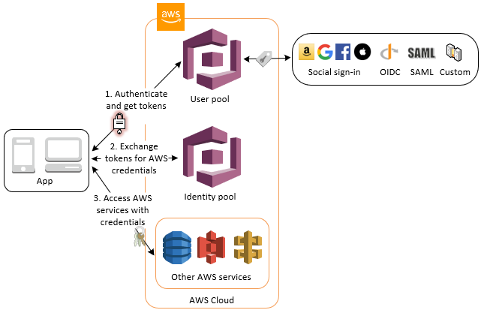

Slide 48

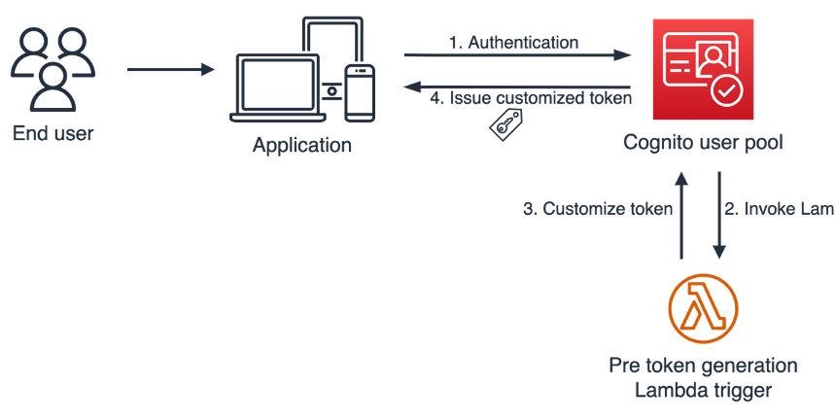

Slide 49
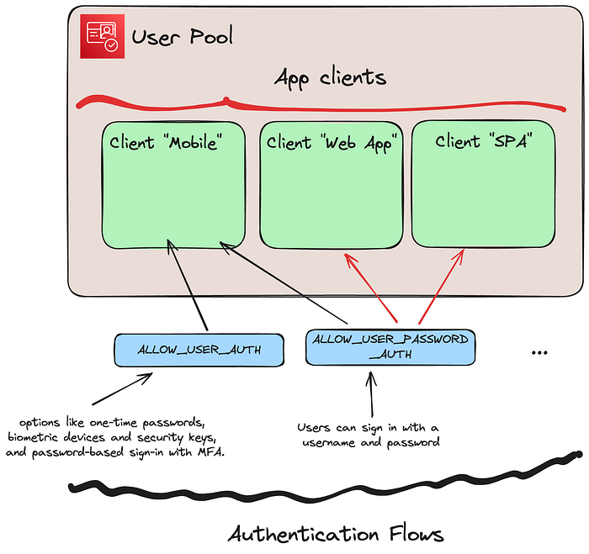

Slide 50
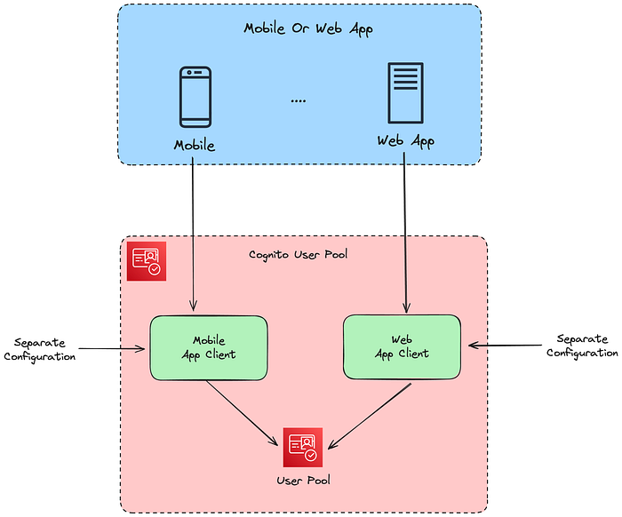

Slide 51
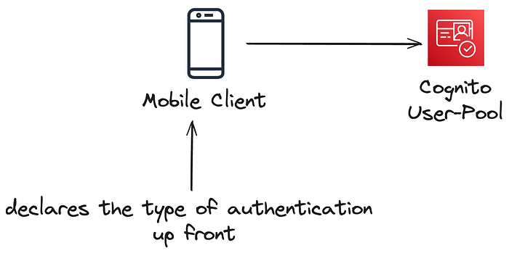
What is Choice-Based Authentication? Instead of locking users into one method of authentication, your app lets them pick from available options, like:
EMAIL_OTP or SMS_OTP: Passwordless sign-in using one-time codes sent via email or text.
WEB_AUTHN: Modern passkey-based sign-in.
PASSWORD: Traditional sign-in with a password.
MFA (Multi-Factor Authentication): Adds extra security after the first sign-in step.

Slide 52
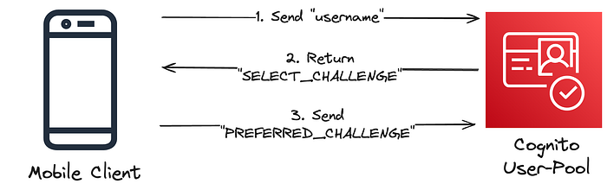
How Does it Work?
Your app starts by collecting the username.
Cognito responds with a “challenge,” which is either:
A list of available sign-in methods (e.g., SMS OTP, email OTP, or password).
The specific method your app requested, if it’s available.

Slide 53
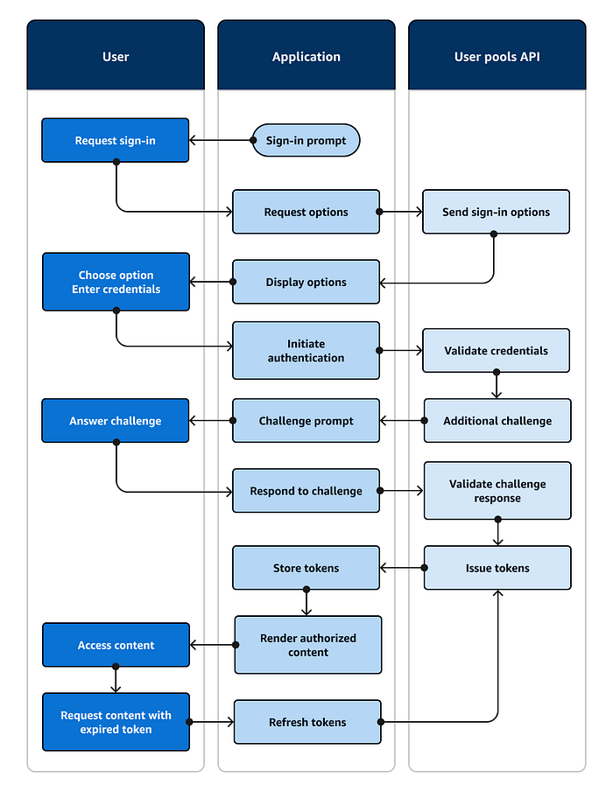

Slide 54
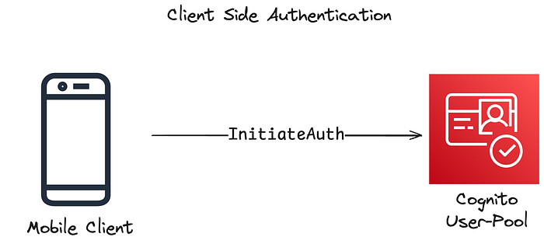
Client-Side (Public) Authentication:
Methods: InitiateAuth and RespondToAuthChallenge
Use Case: Designed for applications running on user devices, such as mobile or single-page applications.
Authorization: These methods do not require AWS Identity and Access Management (IAM) credentials, that means that it does not require a server in the middle between your client and Cognito, your client will directly communicate with Cognito as it will be publically available, making them suitable for environments where embedding such credentials is impractical or insecure.

Slide 55
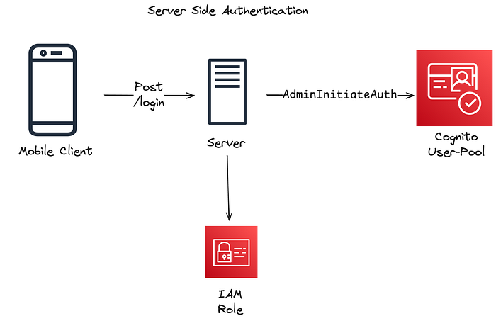
Server-Side (Confidential) Authentication:
Methods: AdminInitiateAuth and AdminRespondToAuthChallenge
Use Case: Intended for server-hosted applications where the backend can securely manage AWS credentials.
Authorization: These methods require IAM credentials, providing an additional layer of security appropriate for confidential client scenarios.

Slide 56
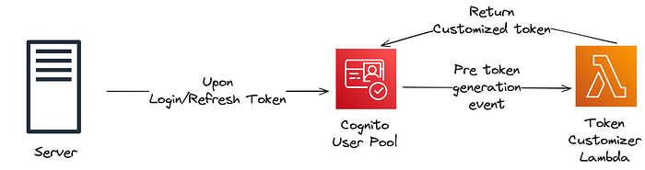

Slide 57
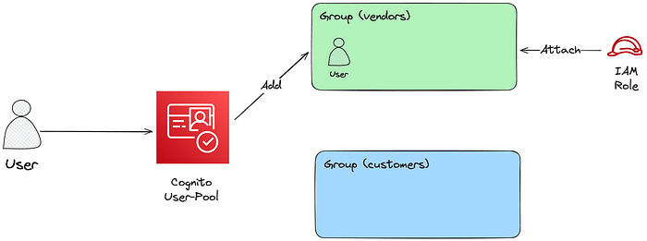
Groups

Slide 58
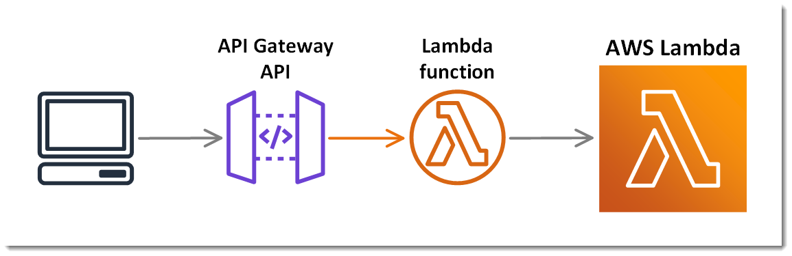
Lambda token signer

Slide 59
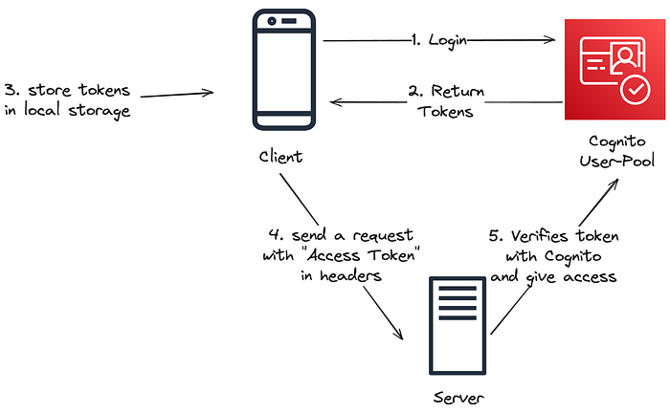
Server-side validation with Cognito token

Slide 60
DB design
Each service has a dedicated schema
Each service connects to database as a service user
Each service user can only access a single schema
Create roles for FX service, Payment service and Ledger service
Create a role for Hasura
Give role Hasura access to above schemas
Expose each schema in Hasura and create actions
Hasura sits on top of all schemas
GRANT USAGE ON SCHEMA hdb_catalog TO service role;
GRANT INSERT ON hdb_catalog.event_log Toservice role;

